Slide 1
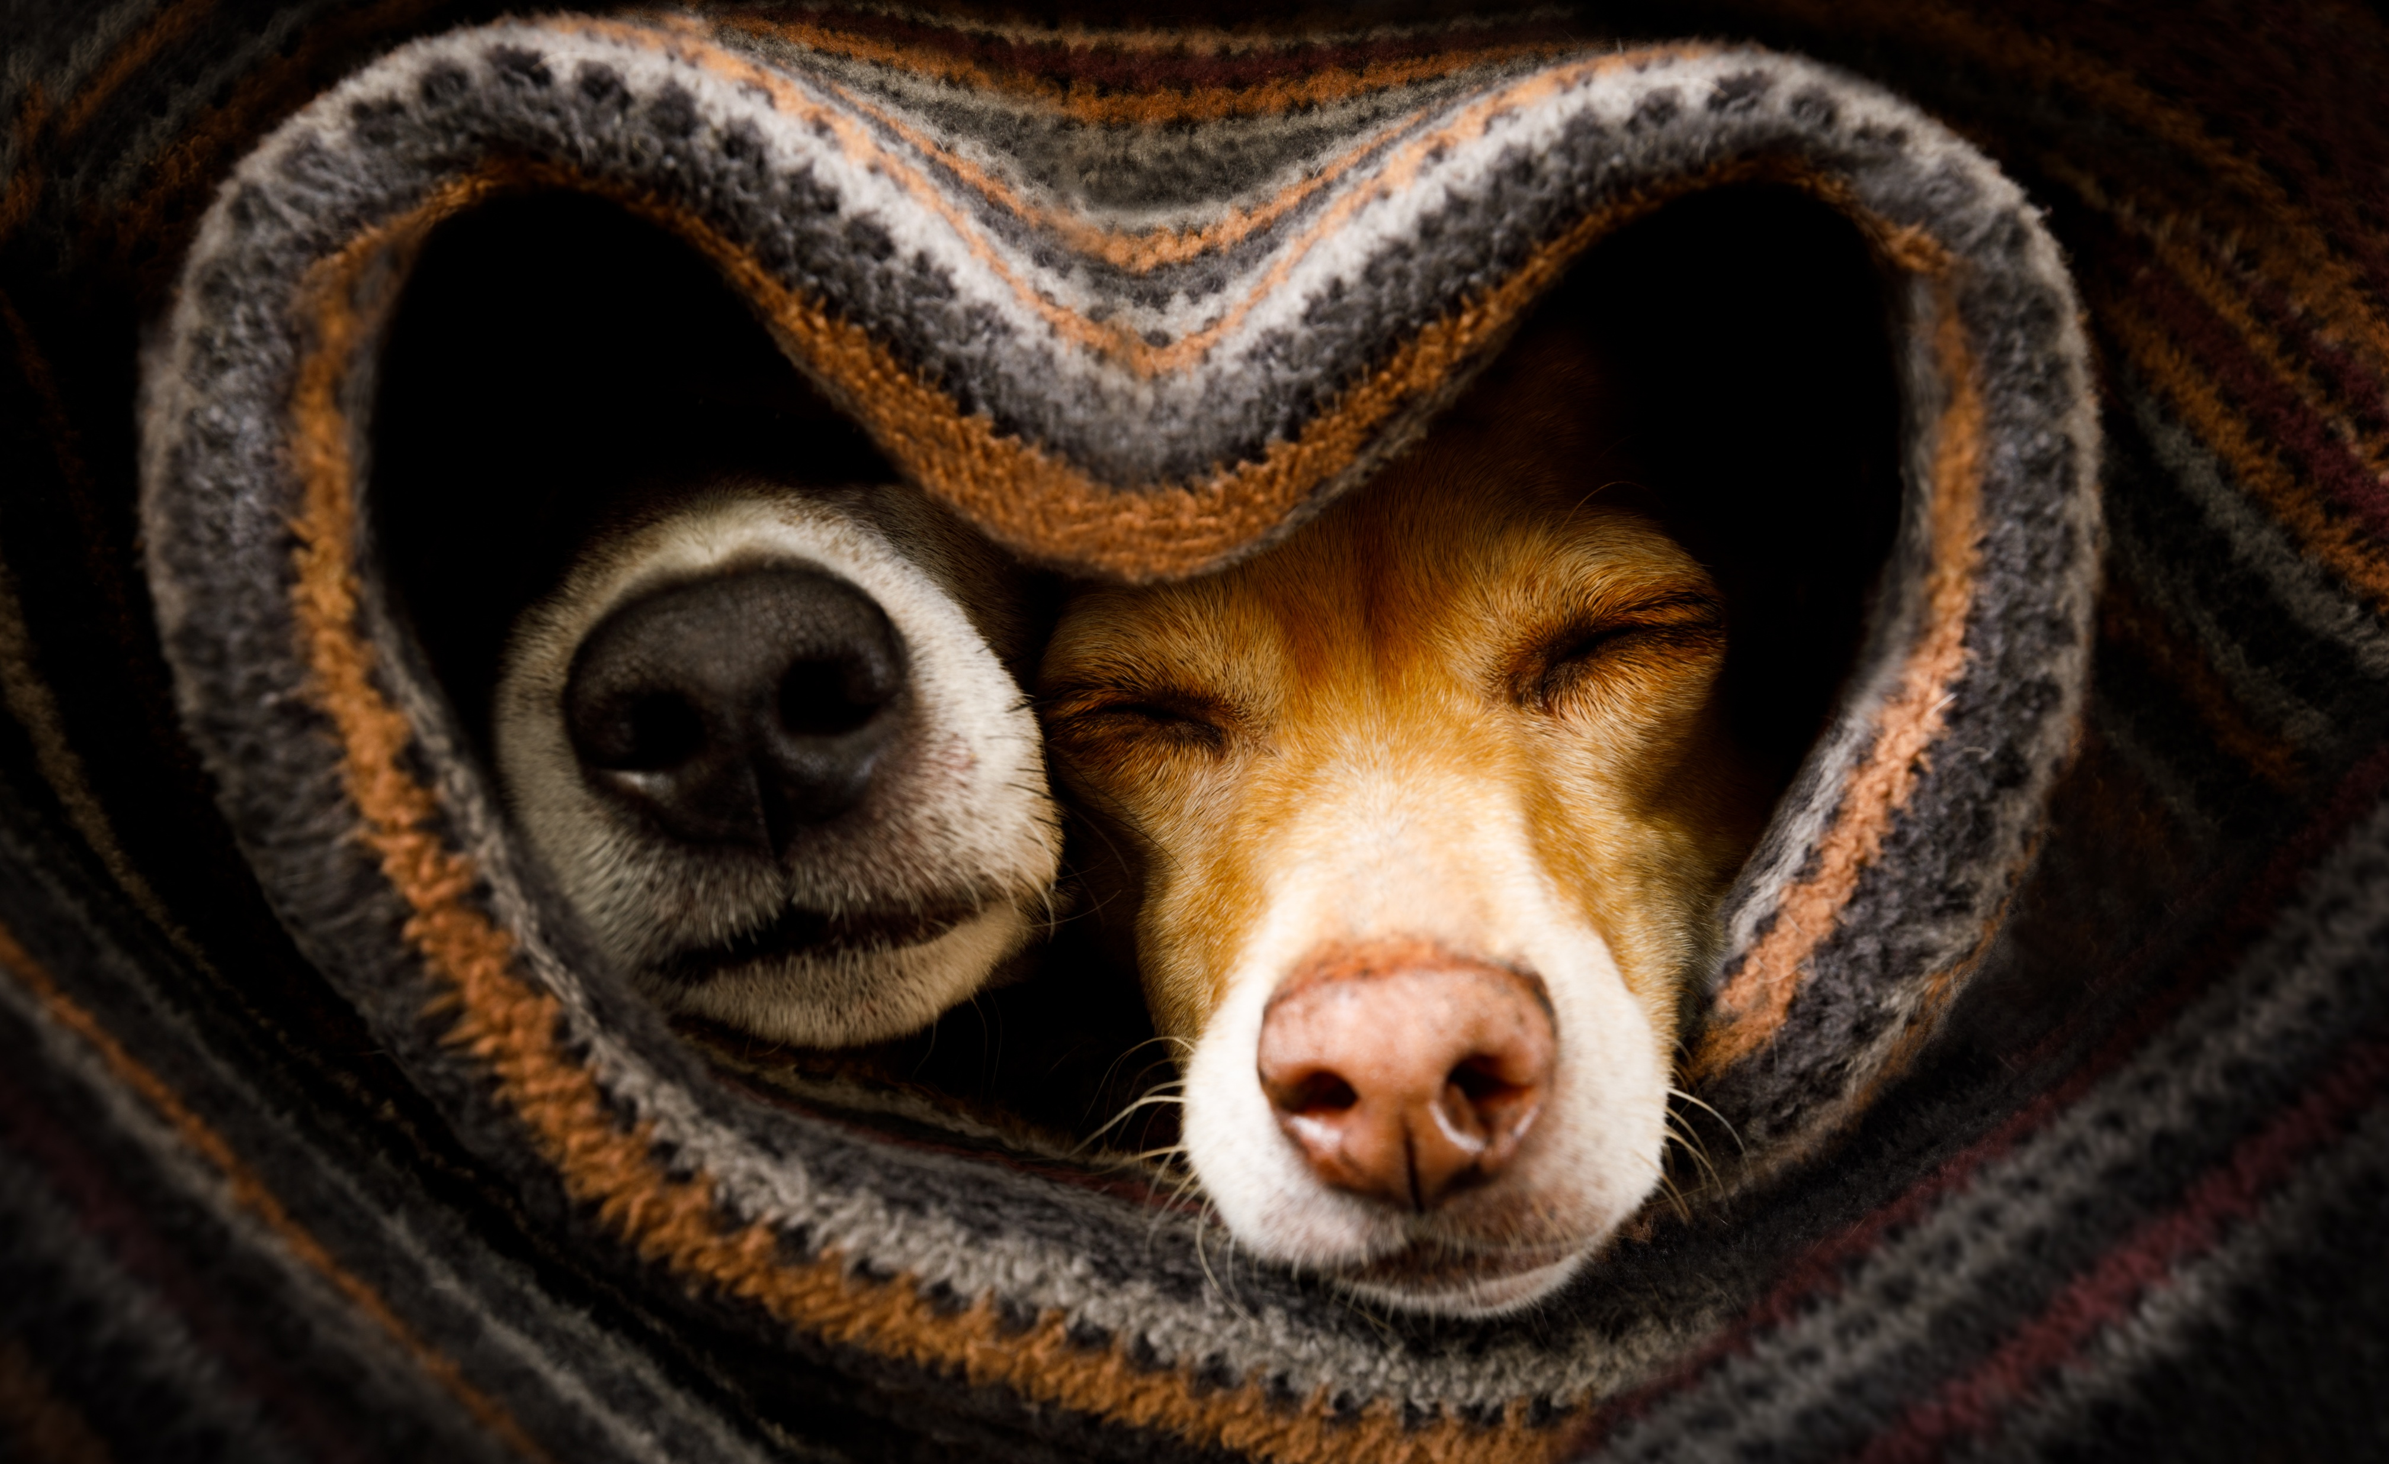
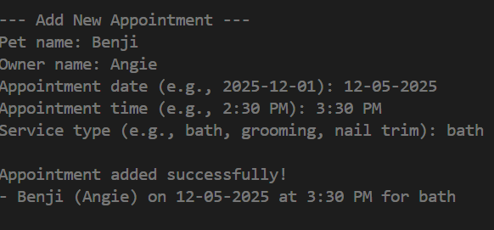

PetPoint
A simple way for small grooming businesses to stay organized.
One appointment at a time
PetPoint is a Python-based appointment management tool designed for small pet grooming businesses.
The app simplifies scheduling by allowing users to create, view, and search appointments for pets and their owners.
https://github.com/ksu-is/PetPoint
Team member: Angela Garcia

